Slide 1
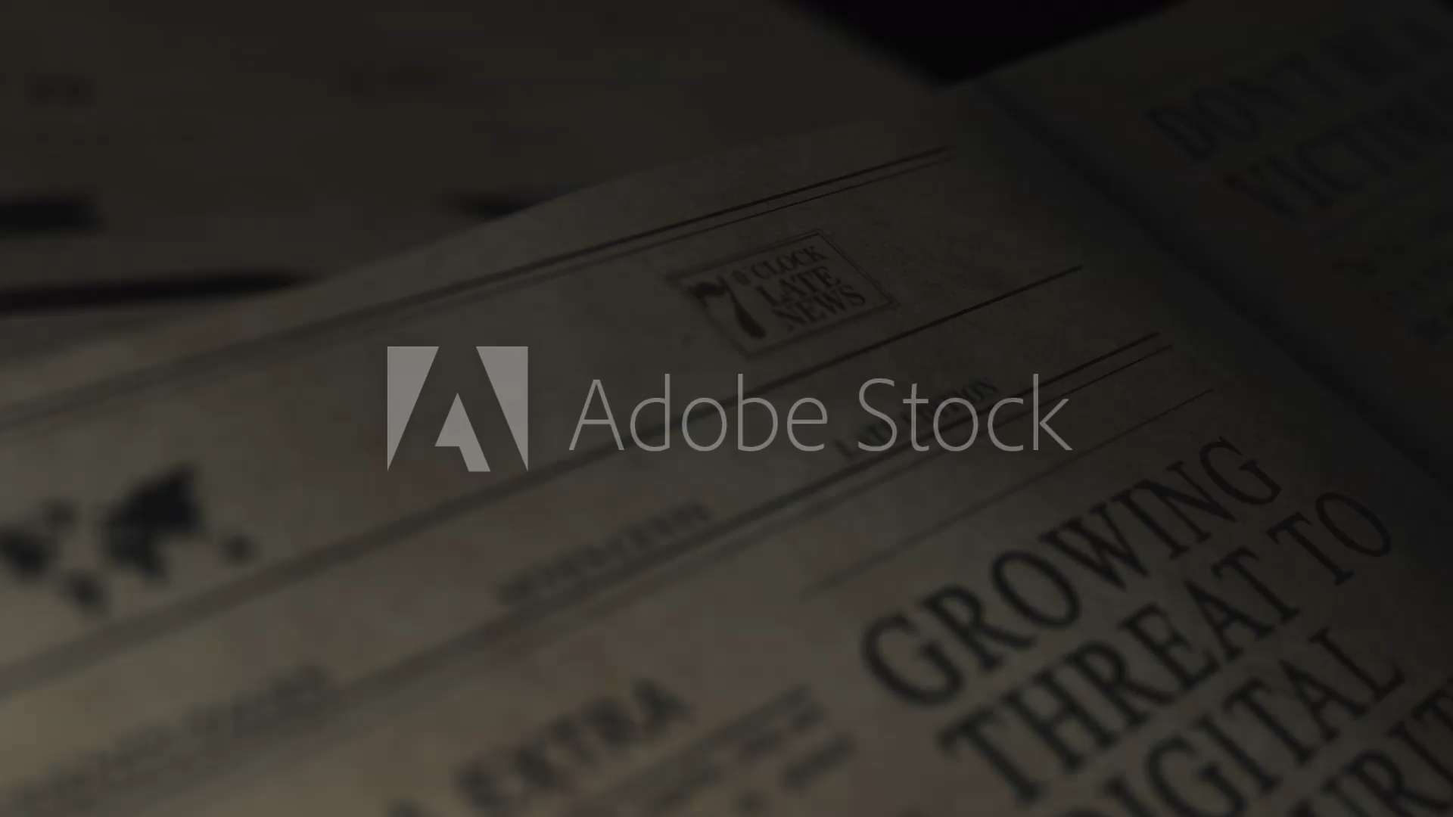
PASSWORD MANAGER

Slide 2
Introduction
Password Managers simplify the complex task of managing multiple passwords for various accounts, providing a streamlined approach to security.
Say goodbye to the burden of memorizing complex strings of characters. Password Managers allow you to generate, store, and autofill strong and unique passwords effortlessly.
Access your passwords securely across multiple devices. Whether it's your laptop, tablet, or smartphone, your passwords are always within reach.
Your passwords are stored in highly secure, encrypted vaults. This adds an extra layer of protection, ensuring that your sensitive information remains confidential.

Slide 3

Understanding Threat Models in the Digital Landscape
Identify your digital threat model – evaluate your online activities and assess the likelihood of being targeted based on your role, access, and visibility.
Explore common cyber threats like phishing, social engineering, and password dumps that can compromise your digital security.
For those with elevated threat models (e.g., business professionals, politicians), adopt additional security measures like multi-factor authentication (MFA) with security keys.”
Understand how cybercriminals leverage publicly available password databases obtained from various data breaches.
Secure your passwords with long, random, and unique combinations stored in a reliable password manager. Strengthen your defense against attacks.”
Implement proactive session management, including regular re-authentication, to mitigate the risks associated with unauthorized access."

Slide 4
Importance of Unique Passwords
Reusing passwords across multiple sites exposes you to higher risks. If one account is compromised, cybercriminals can gain access to other accounts, including sensitive ones like banking or work-related platforms.
The danger of credential stuffing arises when hackers use known passwords from breaches to gain unauthorized access to various accounts. Unique passwords act as a defence against this common attack.
Consider the potential fallout of password compromise in both personal and professional domains. Protecting your digital identity is crucial for maintaining privacy and security.”
Adopt a holistic approach to security by creating and managing distinct passwords for each account. Password managers offer a secure solution by generating and storing complex passwords.”
Long-lasting security measures involve the consistent use of unique passwords. As digital threats evolve, maintaining strong and unique passwords becomes a fundamental aspect of cybersecurity.
Understanding threat models helps in assessing the likelihood of attacks. Educate yourself and others on potential threats and the importance of unique passwords in mitigating these risks.

Slide 5
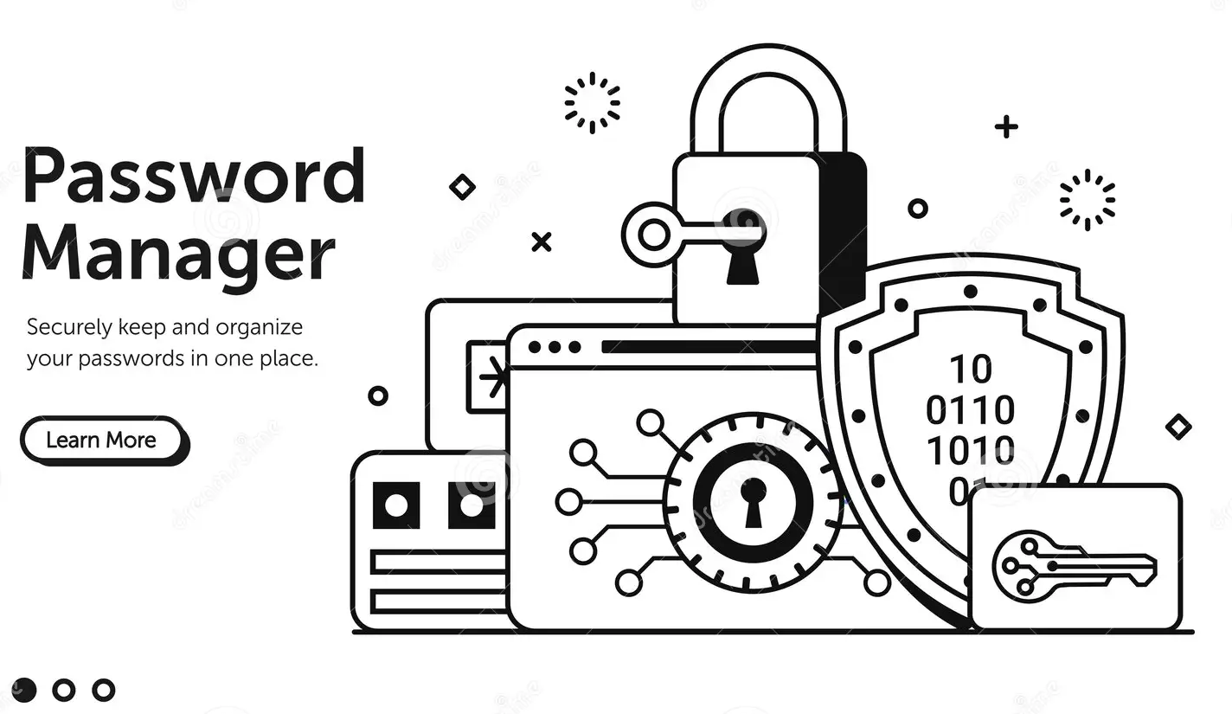
Password Manager
Think of a password manager as your superhero friend who keeps all your secret codes safe. It helps create strong and unique passwords so bad guys can't guess them easily.
Password managers synchronize your passwords, ensuring you have your secure vault at your fingertips whether you're on your laptop, tablet, or smartphone.”
Password managers analyse your password strength, flagging any duplicates or weak entries, empowering you to maintain a robust defence.
Password managers often offer emergency access features, allowing you to designate trusted contacts who can access your passwords in case of an urgent situation.

Slide 6
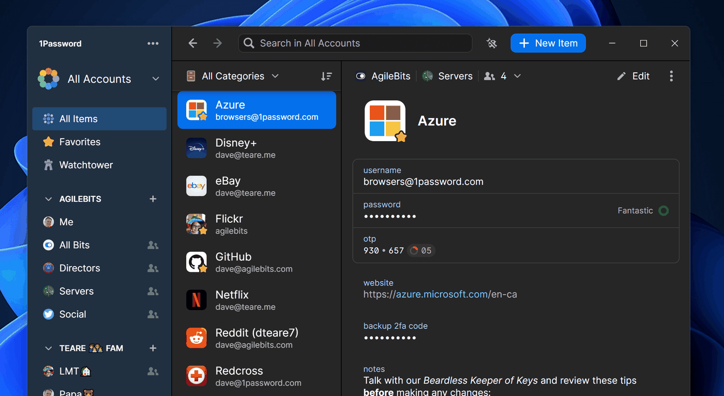

Slide 7
Advantages
You only need to remember one strong password
Forget about forgetting passwords. Your password manager remembers for you!
It's like a shield that protects your secret codes from tricky villains on the internet
Disadvantages
Some people may not trust putting all their codes in one place
It might take a little time to learn how to use it
If you forget the main code for your password helper, it could be a problem.

Slide 8
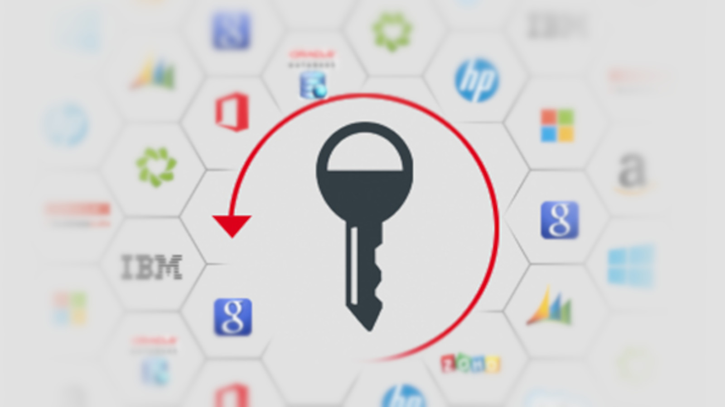
Our mobile phone is not just a gadget, it is a heart of our virtual existence. A single hack has the power to destroy our life in a way we can’t even imagine

Slide 9
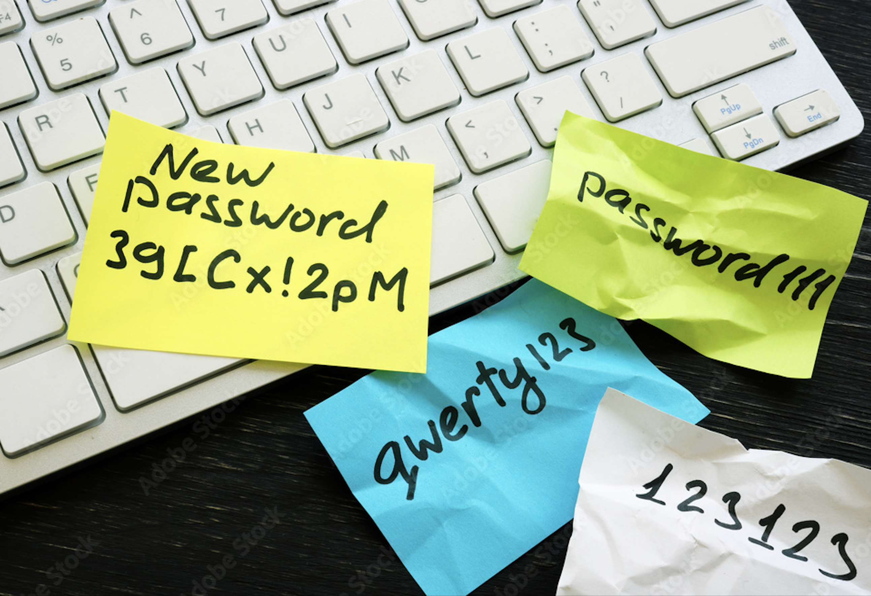
Conclusion
You've discovered a powerful tool—password managers—that acts like a superhero shield for your online accounts
It's not just about passwords; it's like upgrading your digital weapon. Multi-factor authentication adds extra layers, making your online presence ultra-secure
As tech enthusiasts, you're not just followers; you're leaders exploring new tech territories. Keep learning, keep exploring
Conclusion

Slide 10


Contributions
Title | Names
Researcher | Yuvaraj
Coding | Dattatreya
Graphics | Narasimham
Design | Akhilesh

Slide 11

THANK YOU

